Slide 1
Automate your application packaging for Intune
Ben Reader
Notes:
This is the slide shown before the presentation starts. When you are ready to go, tell the video operator to start the recording, and click to the next slide.

Slide 2
5
Video operator, did you start the recording?
Notes:
[REQUIRED SLIDE]
These slides are mandatory and help us with video post-processing. Please keep them as they are.

Slide 3
4
Notes:
[REQUIRED SLIDE]

Slide 4
3
Notes:
[REQUIRED SLIDE]

Slide 5
2
Notes:
[REQUIRED SLIDE]

Slide 6
1
Notes:
[REQUIRED SLIDE]

Slide 7
Automate your application packaging for Intune
Ben Reader
Notes:
This is your opening. Now the stage is yours!

Slide 8
How to insert your Twitter handle
1. On the Insert tab, select Header & Footer.
2. On the Slide tab, check the Footer box.
3. In the box below Footer, type your Twitter handle (e.g. @PSConfEU).
4. To prevent the footer from appearing on the title slide, check the Don't show on title slide box.
5. Click Apply to All button.

Slide 9
This Session
Learn how to automate the publishing and deployment of Win32 applications via Intune. Using CI/CD pipelines in Azure DevOps
Notes:
Please invest some time to reconsider your session: what is it that audience can get out of it? Try and be as precise as you can. If you are showing solutions, then focus on “how to”. If you present about a general technology, you’ll want to stick to “Be able to” or “Understand why/how”.

Slide 10
Agenda
Application deployment in Intune
What is Microsoft Graph?
What is Azure DevOps?
Demo time
Notes:
Psconf.eu is about demos and code. Try and minimize use of text slides

Slide 11
Application Deployment in Intune
App deployment options.
Store app (Android, iOS, Windows Phone, Windows Store)
Office 365 Suite (Windows 10, macOS)
Other (web link, built-in app, line-of-business app)
PowerShell

Slide 12
WINDOWS APP!!!!!!!!!!!!!!

Slide 13
IT SUUUUUUUUUUCKS☹

Slide 14
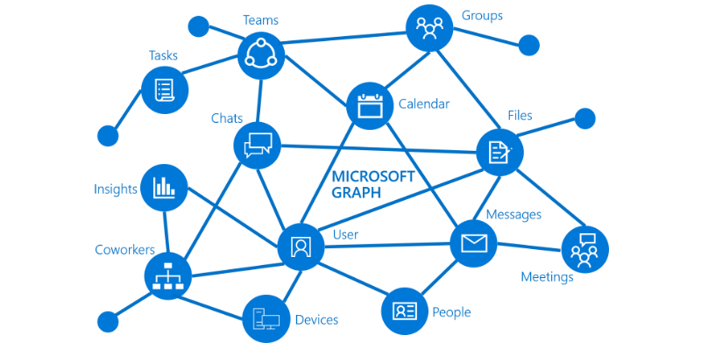
What is Microsoft Graph?
Restful API
Easy access to data for Intune / Office 365
Extensible
One endpoint to rule them all!
Pause for laughter
Notes:
Psconf.eu is about demos and code. Try and minimize use of text slides

Slide 15
What is Azure DevOps?
Originally called Visual Studio Team Services
Private GIT Repos with Azure Repos
CI/CD with Azure Pipelines
Creation of solution artifacts with Azure Artifacts
DevOps in DevOps!

Slide 16
Graph and Azure DevOps together

Slide 17
# Follow these instructions to show perfectly color-coded PowerShell code.
# Paste code to PowerShell ISE, select it, and copy it to the clipboard.
Paste-Code -ToISE | Select-Code | Copy-ToClipboard
# To insert it with full color-coding, paste the code into your slide.
# It will be black, and there is a toolbutton labelled (Ctrl) in PPT.
Click-ToolButton -Choose SymbolWithClipboardAndBrush
# Click the toolbutton, and choose the button that shows a clipboard with a brush.
# This will add color-coding back to the pasted code
PLEASE NOTE: You do not need to use PowerShell ISE to code, or to demo.
Use your preferred editor. With a light theme.
These steps use PowerShell ISE to color-code your code correctly and consistently, and insert the color-coded code into the slide. Please help make all code look consistent. Many thanks!
This is an example of the “Code” layout.
Notes:
To color-code PowerShell code in a consistent way, we ask that you paste your code into PowerShell ISE, select it, and copy it from ISE. Next, paste the code into the text field. It will appear black at first. When you click the small tool button that appears after pasting the code, choose the middle icon with the brush. This adds back the token colors.
Again, use any editor you want during your demos. We ask that you use ISE solely for the purpose of consistently color-coding.
If you use editors other than ISE, make sure you choose a light theme. Dark themes are hard to watch in a presentation room.

Slide 18
Summary
Intune and Office 365 sits atop Microsoft Graph
Restful API
Azure DevOps can automate the whole solution with PowerShell
Build and release pipelines rock
Always test things in a non-prod tenant first
Intune is awesome and so is PowerShell
Notes:
Sum up your key messages

Slide 19
https://github.com/tabs-not-spaces/Intune-Win32-App-Upload
https://github.com/microsoftgraph/powershell-intune-samples
Notes:
[REQUIRED SLIDE]
Make sure you provide all materials that audience needs to reproduce your demos.
Either upload them as a PowerShell module to www.powershellgallery.com (preferred for reusable functions)
Or, upload them to our github repository (ask the girls at the info desk to provide you with access)
Or, upload them to your own github repository
Please make sure all materials are available by the time your presentation starts, or at minimum upload them right after your presentation

Slide 20
Notes:
[REQUIRED SLIDE]
If you sticked to your timing, you now have 15 min left for Q&A. If you missed your timing, you will have to leave the room when your slot is over. In this case, invite your audience to the coffee break and offer to cover questions there.
IN ANY CASE please point your audience to the conference app and the session voting. By the time the conference opens, the eventraft app *should* have the option to vote on sessions.
Please MAKE SURE you leave your room when your slot is over. The next speaker would like to set him/herself up and get everything up and running.

Slide 21


Ben Reader
End User Compute Automation Specialist
Website: powers-hell.com
Github: github.com/tabs-not-spaces
Notes:
Do not EVER discuss this slide during your presentation. Please do not take presentation time to talk about yourself more than just a few introductory sentences. Instead, invite interested audience to the coffee break, and then talk about yourself, your job, your services, etc.
Use this slide to sum up your details. It will be part of the conference materials and recorded videos.

